Slide 1

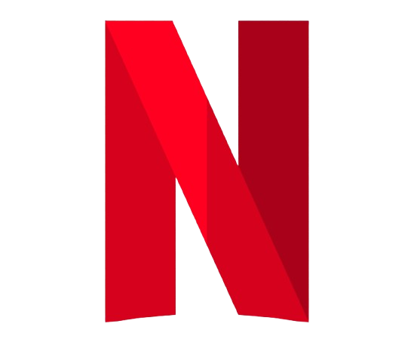
Netflix
the Culture of freedom and responsibility.
How Netflix empowers
creativity and innovation through trust
Prepared by Maksym Lysenkov

Slide 2
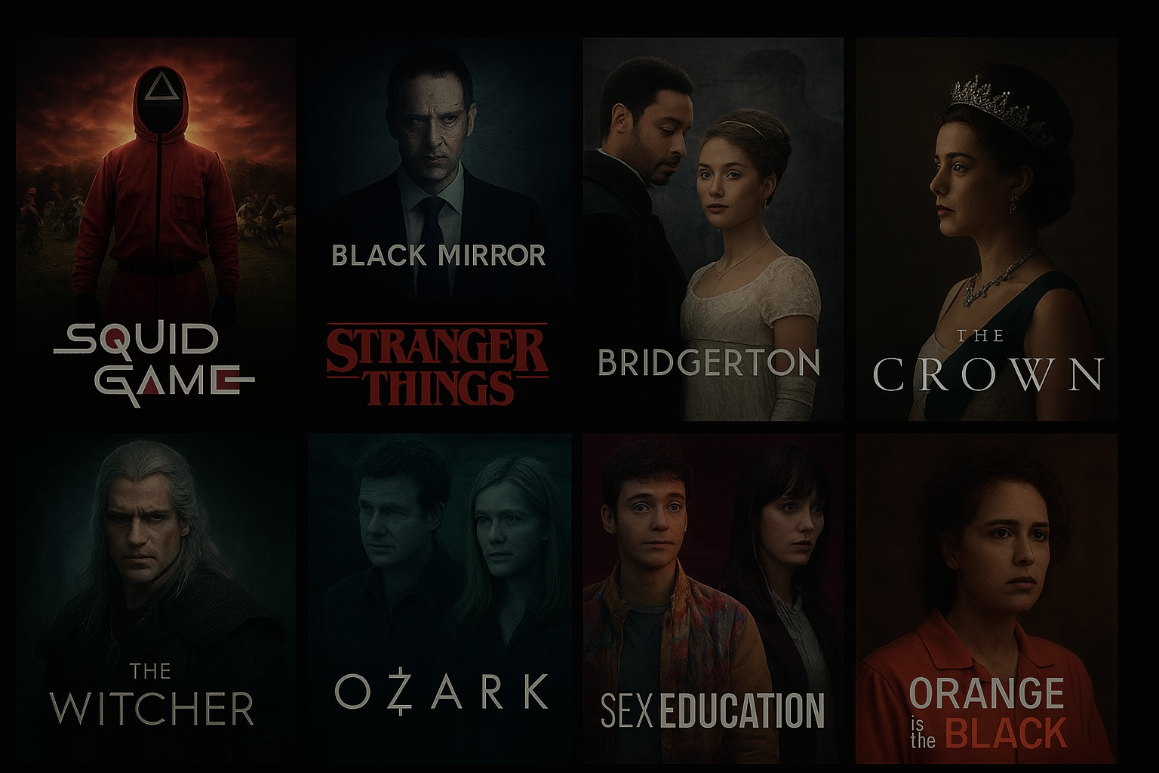
More about Netflix
Founded in 1997 by Reed Hastings and Marc Randolph
Started as a DVD rental service
Now: global streaming giant with over 250 million subscribers
Headquarters: Los Gatos, California

Slide 3
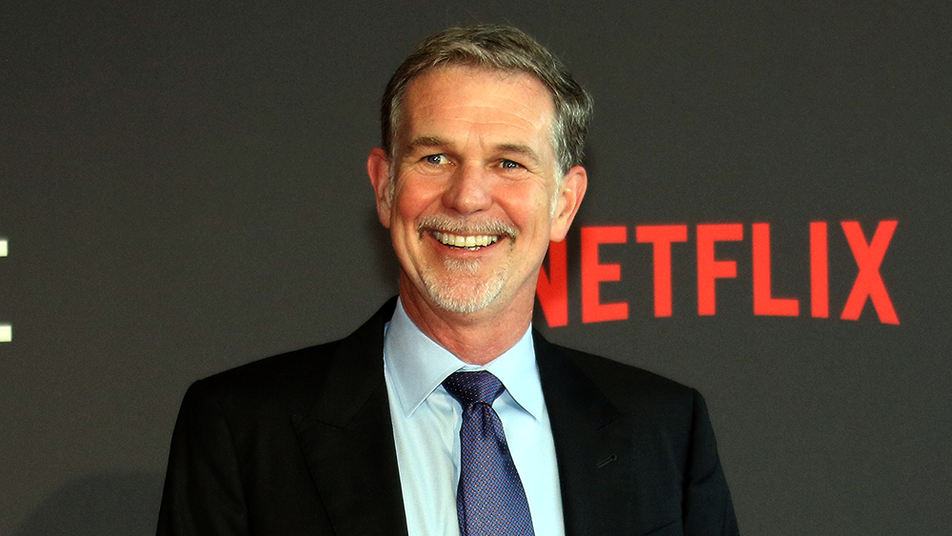
About Reed Hastings the founder
Co-founder and former CEO
Believes in “people over process”
Author of “No Rules Rules” — the
Netflix culture book

Slide 4
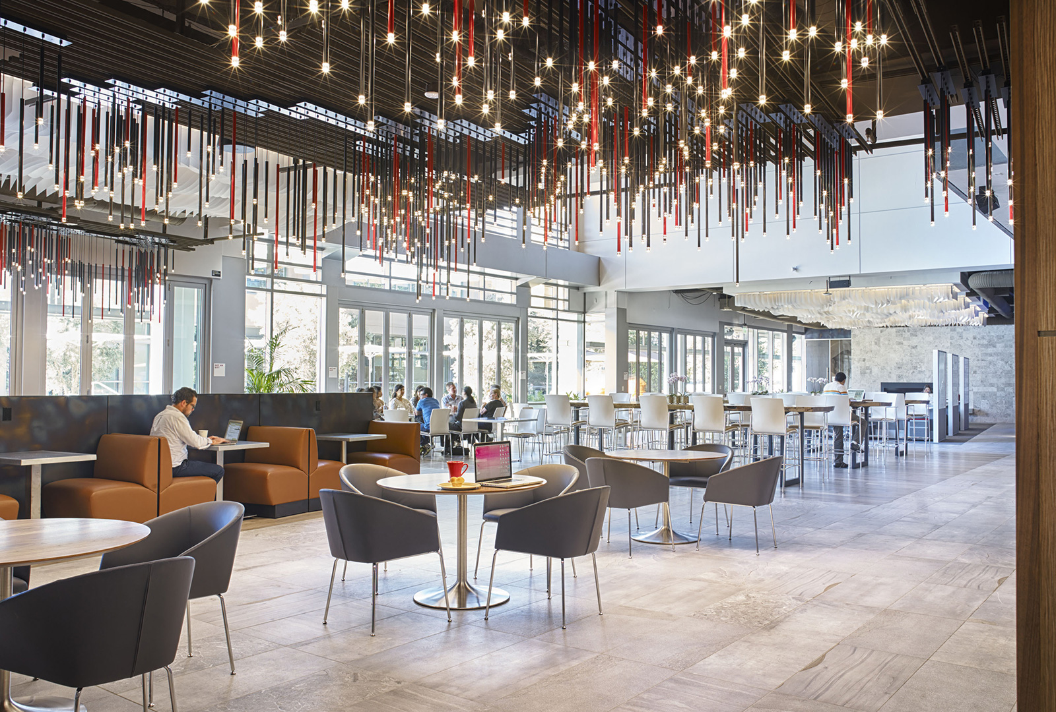
Netflix Culture: Freedom + Responsibility
Employees choose their own projects
No micromanagement or vacation limits
Open feedback culture
“Context, not control”

Slide 5

Key Principles
High talent density
Open and honest communication
Freedom to innovate
Responsibility for results

Slide 6

Innovation Through Trust
Creative teams have full decision power
No approvals from top managers
Fast production and innovation

Slide 7
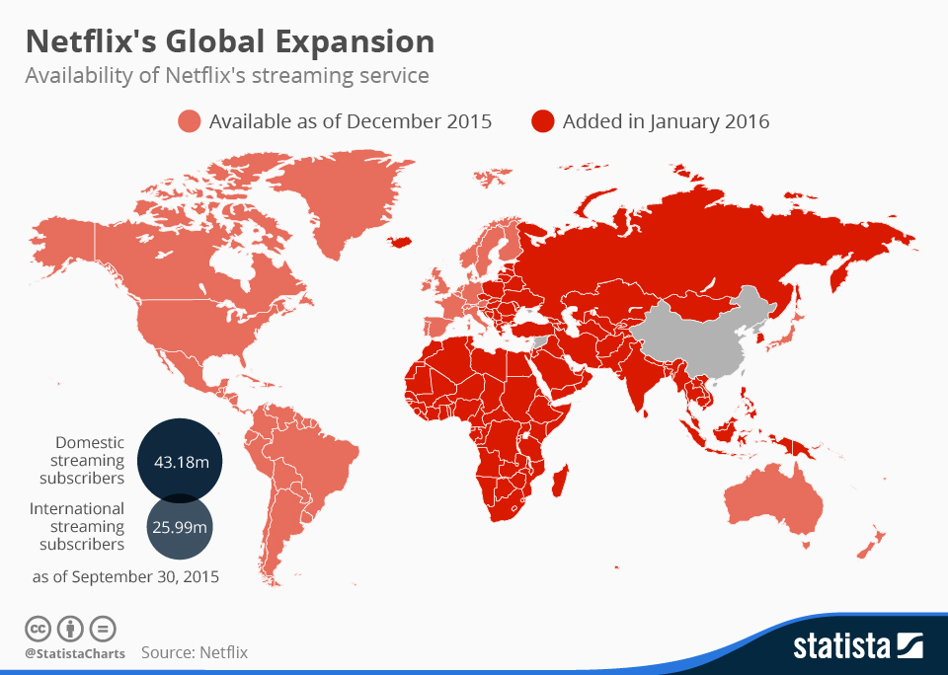
Global Impact
Creative teams have full decision power
No approvals from top managers
Fast production and innovation

Slide 8

Conclusion
Freedom + Responsibility = Innovation
Trust leads to creativity
Culture is Netflix’s greatest advantage

Slide 9
Thanks for Your attention
<3

